Slide 1
Data Cleaning &
Correlation Analysis
messy_dataset_Mukesh.csv

Slide 2
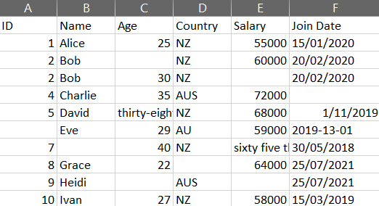
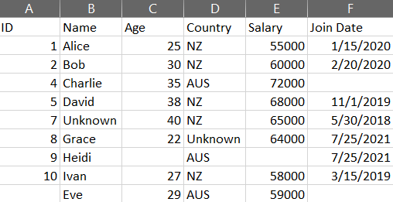
Data Analysis
Cell | Issue | Value Found | Fix Applied
C6,E8 | Text-encoded numbers | thirty-eight / sixty five thousand | Replaced with 38 / 65000
D7 | Wrong country code | AU | Replaced with AUS
F5,F7 | Invalid / missing date | Month 13 / Empty | Coerced to NaT
A3,A4 | Duplicate rows (Bob) | ID=2 appears twice | Merged into one row
C3,C10,E4,E10,A7 | Missing numeric values | Empty | Left as NaN
B8,D9 | Missing text values | Empty | Filled with Unknown
Original
Cleaned

Slide 3
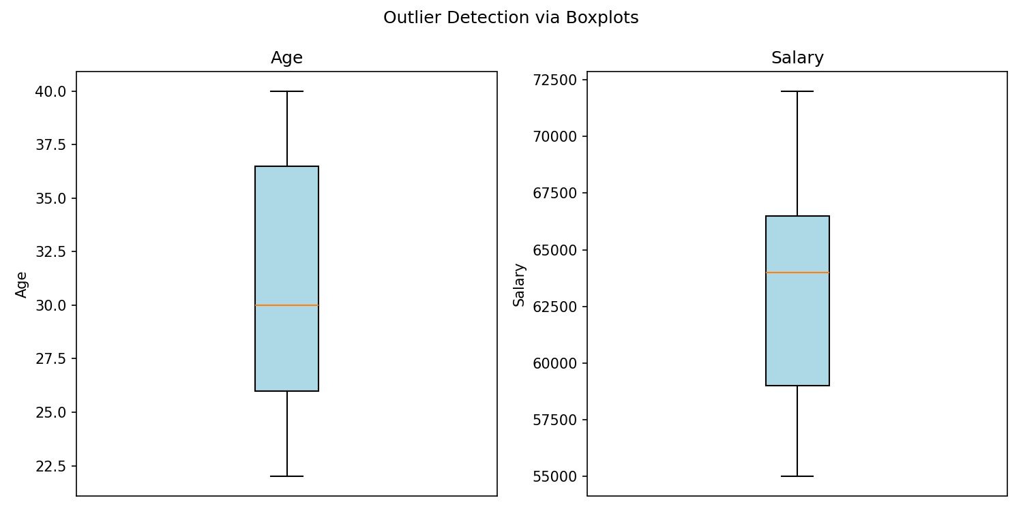
Outlier Detection — Boxplots
No outliers detected. All values fall within the expected range. Expected range was calculated by matplotlib using IQR formula.

Slide 4
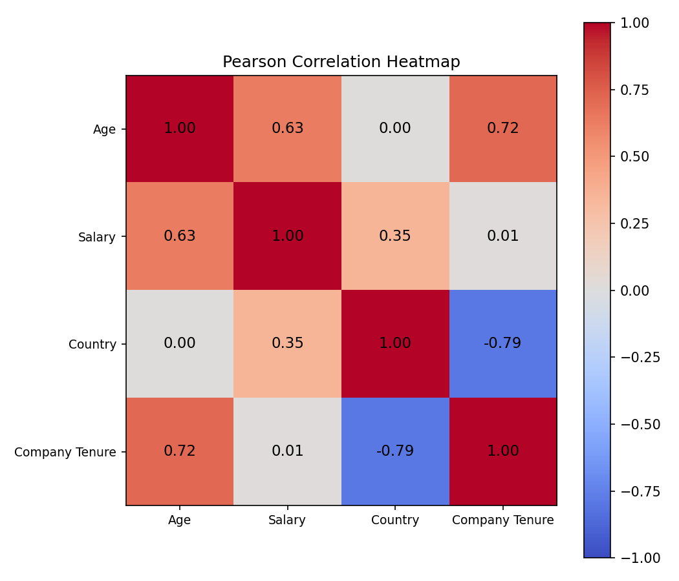
Pearson Correlation Heatmap
Relevant Relationships:
Age vs Salary (r=0.63): Moderate positive relationship. Older employees tend to earn more.
Supporting Relationships:
Salary vs Company Tenure (r=0.01): Almost no relationship. Length of service does not predict salary in this dataset.
Salary vs Country (r=0.35): Weak positive relationship. AUS employees tend to earn slightly more than NZ employees.
Less Relevant:
Age vs Company Tenure (r=0.72): Strong positive relationship. Older employees tend to have longer company tenure.
Company Tenure vs Country (r=-0.79): Strong negative relationship. NZ employees tend to have longer tenure than AUS employees.
Age vs Country (r=0.00): No relationship. Age is not linked to which country the employee is from.

